Slide 1
Fixed Axis Rotation in Rigid Bodies (Vectors)
Dr. Agnes d’Entremont
Associate Professor of Teaching
Mechanical Engineering, University of British Columbia
(Original slides: Dr. Jacob Moore)

Slide 2
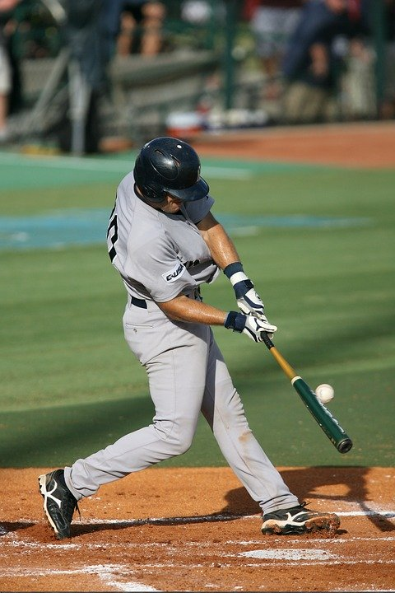
Rigid Body Kinematics
So far, we have talking about particles, where we are only concerned with the location, velocity, and acceleration of the particle.
If now we are going to start talking about rigid bodies, where we will be concerned with the orientation, angular velocity, and angular acceleration of the object as well.

Slide 3
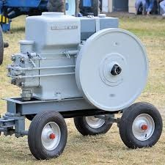
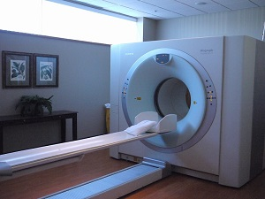
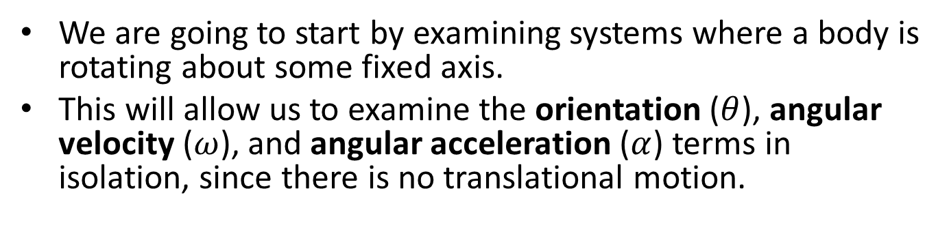
Fixed Axis Rotation
We are going to start by examining systems where a body is rotating about some fixed axis.
This will allow us to examine the orientation ($θ$), angular velocity ($ω$), and angular acceleration ($α$) terms in isolation, since there is no translational motion.

Slide 4
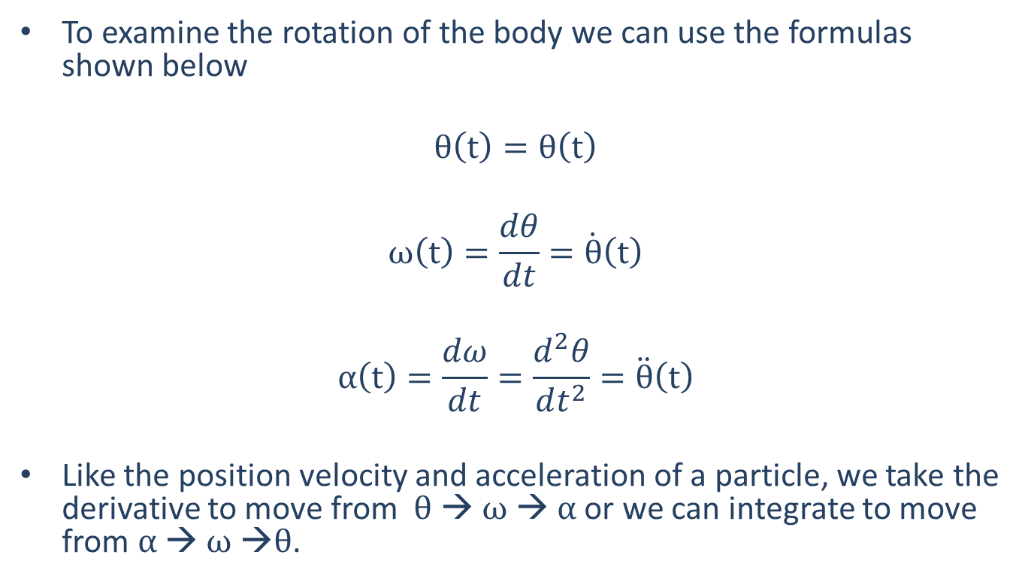
Fixed Axis Rotation
To examine the rotation of the body we can use the formulas shown below
$$θ\left(t\right)=θ\left(t\right)$$
$$ω\left(t\right)=\frac{dθ}{dt}=\dot{θ}\left(t\right)$$
$$α\left(t\right)=\frac{dω}{dt}=\frac{d^{2}θ}{dt^{2}}=\ddot{θ}\left(t\right)$$
Like the position velocity and acceleration of a particle, we take the derivative to move from $θ$ → $ω$ → $α$ or we can integrate to move from $α$ → $ω$ →$θ$.

Slide 5
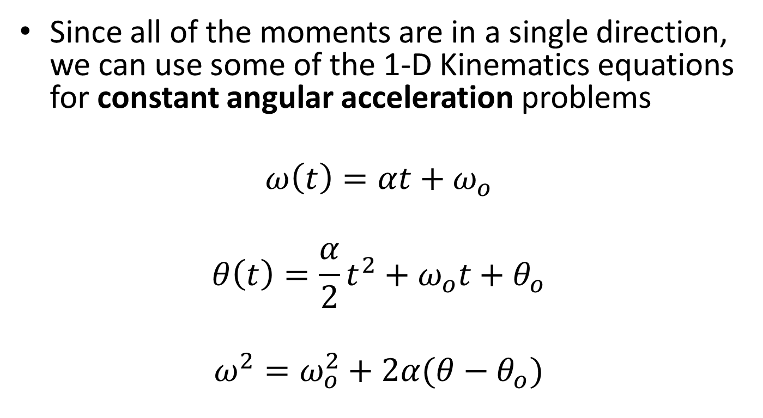
Fixed Axis Rotation
Since all of the moments are in a single direction, we can use some of the 1-D Kinematics equations for constant angular acceleration problems
$$ω\left(t\right)=αt+ω_{o}$$
$$θ\left(t\right)=\frac{α}{2}t^{2}+ω_{o}t+θ_{o}$$
$$ω^{2}=ω_{o}^{2}+2α(θ−θ_{o})$$

Slide 6


Planar Motion and the Direction of Rotation
Translation
(rectangular)
$\vec{r}\left(t\right)= x\left(t\right)\hat{i}+y\left(t\right)$ $\hat{j}$
$$\vec{v}\left(t\right)= \dot{x}\left(t\right)\hat{i}+\dot{y}\left(t\right)\hat{j}$$
$$\vec{a}\left(t\right)= \ddot{x}\left(t\right)\hat{i}+\ddot{y}\left(t\right)\hat{j}$$
Rotation
$$\vec{θ}\left(t\right)=θ\left(t\right)\hat{k}$$
$$\vec{ω}\left(t\right)=\dot{θ}\left(t\right)\hat{k}$$
$$\vec{α}\left(t\right)=\ddot{θ}\left(t\right)\hat{k}$$
Similar to the way moments work, the axis of rotation, along with the right hand rule indicates the “direction” of the rotation.

Slide 7

Motion of a Point in Fixed Axis Rotation
Any point on the record will have a velocity and acceleration
The record as a whole is being rotated about a fixed point
As we look at motion about a fixed axis, the material on the axis of rotation is not moving, but all points not on the axis of rotation are moving.
To discuss the motion of a point on a rotating body, we will use vectors in rectangular coordinates.

Slide 8



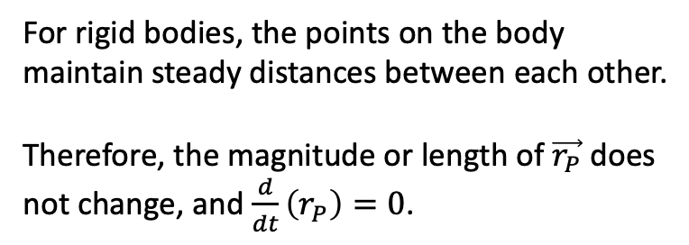
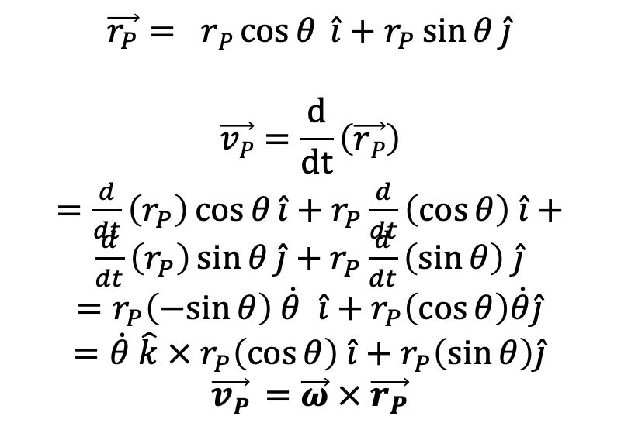






Vectors in Fixed Rotation
For rigid bodies, the points on the body maintain steady distances between each other.
Therefore, the magnitude or length of $\vec{r_{P}}$ does not change, and $\frac{d}{dt}\left(r_{P}\right)=0$.
$$y$$
$$\vec{v_{P}}$$
$$\vec{α}$$
$$\vec{r_{P}}$$
$$P$$
$$\vec{ω}$$
$$θ$$
$$\vec{r_{P}}= rP\cos{θ} \hat{i}+r_{P}\sin{θ}\hat{j}$$
$$\vec{vP}=\frac{d}{dt}\left(\vec{rP}\right)$$
$=\frac{d}{dt}\left(r_{P}\right)\cos{θ}\hat{i}+r_{P}\frac{d}{dt}\left(\cos{θ}\right) \hat{i}+$ $\frac{d}{dt}\left(r_{P}\right)\sin{θ}\hat{j}+$ $r_{P}\frac{d}{dt}\left(\sin{θ}\right) \hat{j}$
$=r_{P}\left(−sin{θ}\right) \dot{θ} \hat{i}+$ $r_{P}\left(\cos{θ}\right)\dot{θ}\hat{j}$
$={\dot{θ} \hat{k} × r}_{P}\left(\cos{θ}\right) \hat{i}+$ $r_{P}\left(\sin{θ}\right)\hat{j}$
$$\vec{vP} =\vec{ω} × \vec{r_{P}}$$
$$x$$
$$O$$

Slide 9



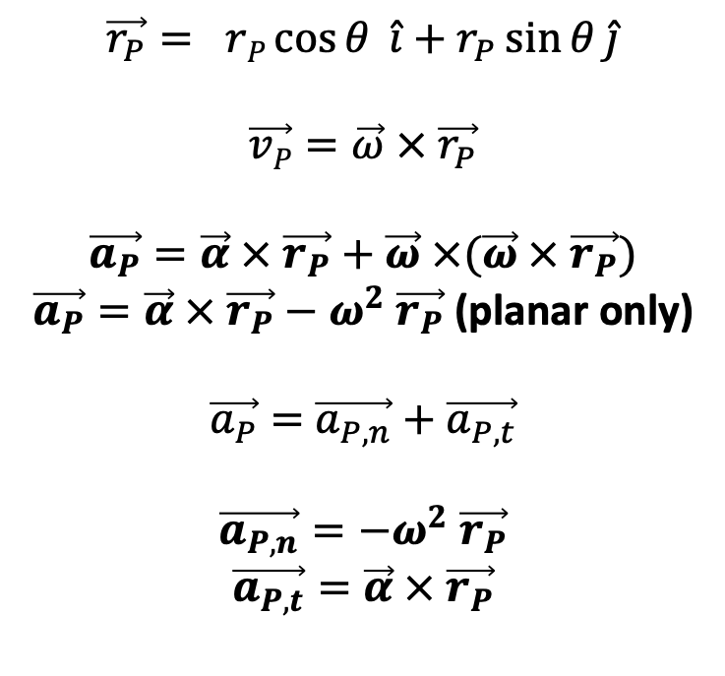
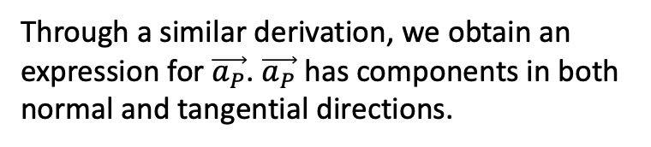


Vectors in Fixed Rotation
$$t$$
Through a similar derivation, we obtain an expression for$\vec{a_{P}}$. $\vec{a_{P}}$ has components in both normal and tangential directions.
$$\vec{a_{P,t}}$$
$$y$$
$$n$$
$$\vec{r_{P}}= rP\cos{θ} \hat{i}+r_{P}\sin{θ}\hat{j}$$
$$\vec{vP}=\vec{ω} × \vec{r_{P}}$$
$$\vec{a_{P}}=\vec{α} × \vec{r_{P}}+\vec{ω} ×(\vec{ω} × \vec{r_{P}})$$
$\vec{a_{P}}=\vec{α} × \vec{r_{P}}−ω^{2} \vec{r_{P}}$ (planar only)
$\vec{a_{P}}=$ $\vec{a_{P,n}}+$ $\vec{a_{P,t}}$
$$\vec{a_{P,n}}=−ω^{2} \vec{r_{P}}$$
$$\vec{a_{P,t}}=\vec{α} × \vec{r_{P}}$$
$$\vec{α}$$
$$\vec{a_{P,n}}$$
$$P$$
$$\vec{ω}$$
$$\vec{r_{P}}$$
$$θ$$
$$x$$
$$O$$

Slide 10




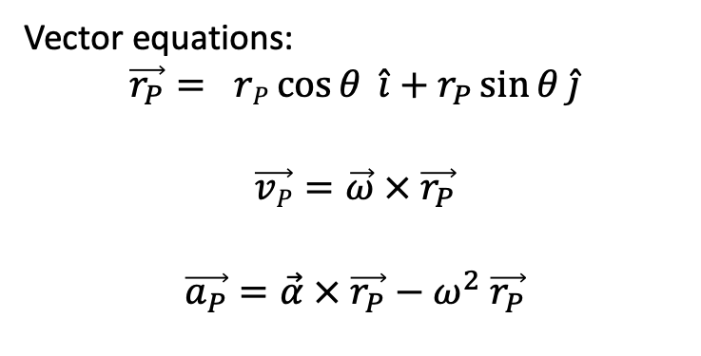

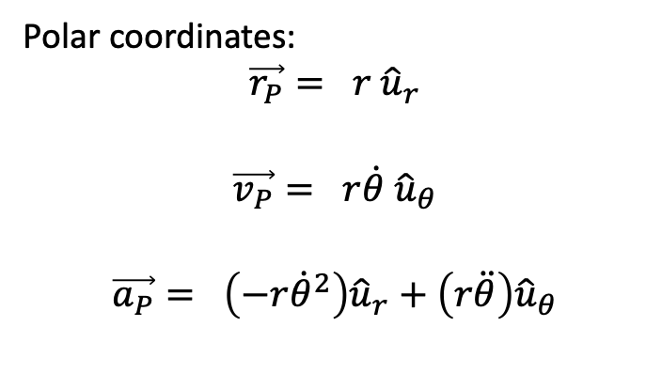



Comparison to Polar Coordinates
Reminder, $\dot{r}$ and $\ddot{r}$ variables are zero:
Polar coordinates:
$$\vec{r_{P}}= r {\hat{u}}_{r}$$
$$\vec{v_{P}}= r\dot{θ} {\hat{u}}_{θ}$$
$$\vec{a_{P}}= \left(−r{\dot{θ}}^{2}\right){\hat{u}}_{r}+\left(r\ddot{θ}\right){\hat{u}}_{θ}$$
$$y$$
$${\hat{u}}_{r}$$
$$\vec{α},\ddot{θ}$$
$$\vec{r_{P}}$$
$$P$$
$$\vec{ω},\dot{θ}$$
$${\hat{u}}_{θ}$$
$$θ$$
$$x$$
$$O$$
Vector equations:
$$\vec{r_{P}}= rP\cos{θ} \hat{i}+r_{P}\sin{θ}\hat{j}$$
$$\vec{vP}=\vec{ω} × \vec{r_{P}}$$
$$\vec{a_{P}}=\vec{α} × \vec{r_{P}}−ω^{2} \vec{r_{P}}$$

Slide 11



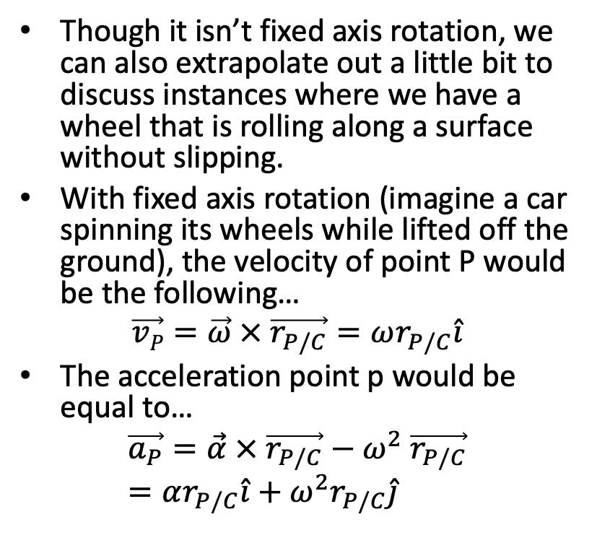



Rolling Without Slipping
$$y$$
$$x$$
Though it isn’t fixed axis rotation, we can also extrapolate out a little bit to discuss instances where we have a wheel that is rolling along a surface without slipping.
With fixed axis rotation (imagine a car spinning its wheels while lifted off the ground), the velocity of point P would be the following…
$$\vec{vP}=\vec{ω} × \vec{r_{P/C}}=ωr_{P/C}\hat{i}$$
The acceleration point p would be equal to…
$$\vec{a_{P}}=\vec{α} × \vec{r_{P/C}}−ω^{2} \vec{r_{P/C}}=αr_{P/C}\hat{i}+ω^{2}r_{P/C}\hat{j}$$
$\vec{ω}$, $\vec{α}$
$$C$$
$$P$$

Slide 12
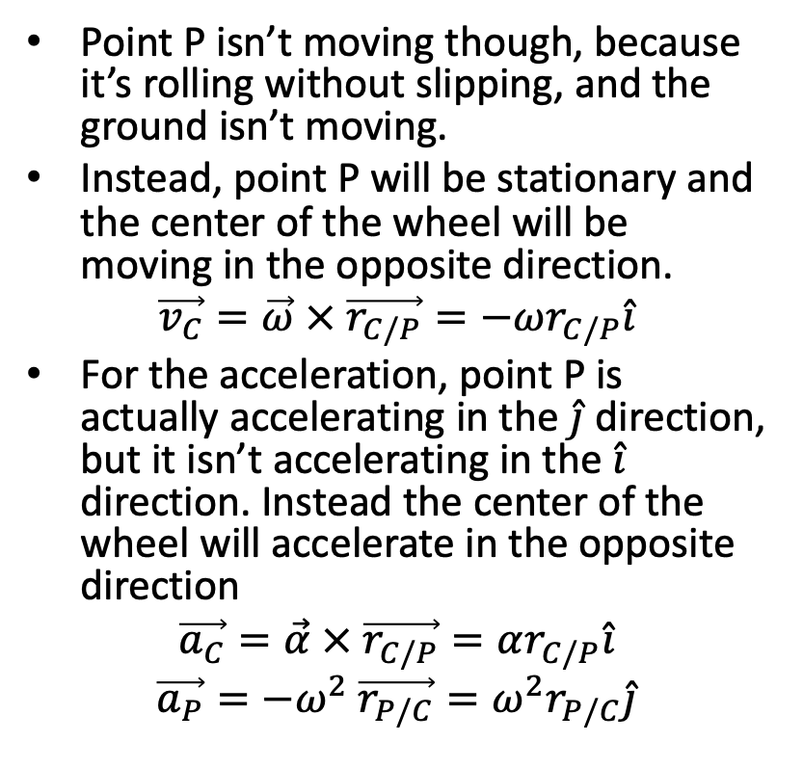
Rolling Without Slipping
$$y$$
$$x$$
Point P isn’t moving though, because it’s rolling without slipping, and the ground isn’t moving.
Instead, point P will be stationary and the center of the wheel will be moving in the opposite direction.
$$\vec{v_{C}}=\vec{ω} × \vec{r_{C/P}}=−ωr_{C/P}\hat{i}$$
For the acceleration, point P is actually accelerating in the $\hat{j}$ direction, but it isn’t accelerating in the $\hat{i}$ direction. Instead the center of the wheel will accelerate in the opposite direction
$$\vec{a_{C}}=\vec{α} × \vec{r_{C/P}}=αr_{C/P}\hat{i}$$
$$\vec{a_{P}}=−ω^{2} \vec{r_{P/C}}=ω^{2}r_{P/C}\hat{j}$$
$\vec{ω}$, $\vec{α}$
$$C$$
$$P$$

Slide 13
Thanks for Watching
See other engineering mechanics videos and access the full tool at …

Slide 14
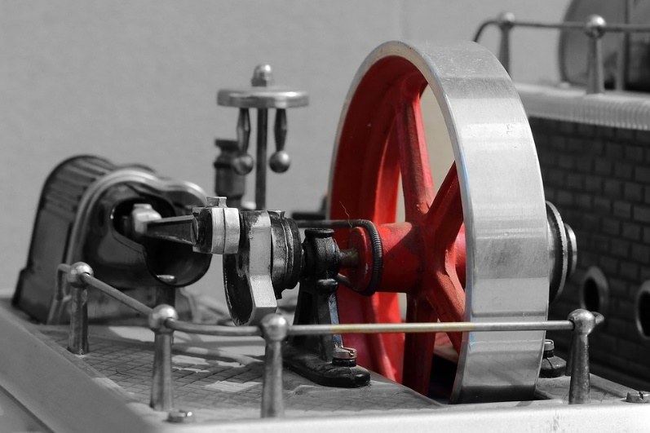
Fixed Axis Rotation Worked Example
A flywheel on a fixed axel is rotating at a rate of 600 rpm. A brake then decelerates the flywheel at a rate of 30 rad/s² until stopping.
What is the time required to stop the flywheel?
How many rotations does the flywheel go through while decelerating?

Slide 15

Worked Example
An 8cm hard drive platter is spinning at 3600 rpm. What is the velocity of a point on the edge of the platter?
What is the acceleration of a point on the edge of the hard drive platter?

Slide 16




$$y$$
$$x$$
$$P$$
$$O$$

Slide 17



$$y$$
$$x$$
$$θ$$
$$O$$
$$P$$

Slide 18

$$y$$
$$x$$
$$O$$
$$P$$
$$θ$$

Slide 19

$$y$$
$$x$$
$$φ$$
$$O$$
$$P$$
$$θ$$

Slide 20








$$y$$
$$\vec{v_{P}}$$
$$\vec{α}$$
$$\vec{r_{P}}$$
$$P$$
$$\vec{ω}$$
$$θ$$
$$x$$
$$O$$

Slide 21






$$t$$
$$\vec{a_{P,t}}$$
$$y$$
$$n$$
$$\vec{α}$$
$$\vec{a_{P,n}}$$
$$P$$
$$\vec{ω}$$
$$\vec{r_{P}}$$
$$θ$$
$$x$$
$$O$$

